Slide 1
Design and Implement Cloud Data Platform Solutions

Slide 2
03 | Implement SQL Database

Slide 3
Agenda
1
Microsoft Cloud Data Platform
5
Hybrid HA/DR Scenarios with SQL Server
2
Implement SQL Server on Azure VM
6
Design and Implement Security
3
Implement SQL Database
7
Monitor and Manage Implementations on Azure
4
SQL Database High Availability and Disaster Recovery
8
Design and Implement Database Solutions for SQL Server and SQL Database

Slide 4
In this module
What is SQL Database
Elastic Database Tools
Data Tiers / Elastic data tiers
SQL Database performance
Scalability Options
Service Tier Advisor
Elastic Databases

Slide 5
Data platform continuum
On premises
Hybrid Cloud
Off premises
Shared Lower cost
Platform as a service
Software as a service
Infrastructure as a service
Azure SQL Database
Virtualized Databases
Virtual
SQL Server in Azure VM
Virtualized Machines
Physical
SQL Server Private Cloud
Virtualized Machines + Appliances
SQL Server
Physical Machines (raw iron)
Dedicated Higher cost
Higher administration
Lower administration

Slide 6
What is SQL Database
A relational database as a service, fully managed by Microsoft.
For cloud-designed apps when near-zero administration and enterprise-grade capabilities are key.
Perfect for cloud architects and developers looking for programmatic DBA-like functionality.
Elastic scale and performance
Business continuity and data protection
Familiar and self-managed
Predictable performance levels
Programmatic scale-out
Dashboard views of database metrics
Self-service restore
Disaster recovery
Compliance-enabled
Familiar and compatible
Programmatic
Self-managed

Slide 7
SQL Database single-database service tiers
Basic
Standard
Premium
Built for | Light transactional workloads | Medium transactional workloads | Heavy transactional workloads
Availability SLA | 99.99%*
Database max size | 2 GB | 250 GB | 1 TB
Point-in-time restore (“oops” recovery) | Any point within 7 days | Any point within 14 days | Any point within 35 days
Business continuity | Geo-restore | Geo-replication, standby secondary | Active geo-replication, up to four readable secondaries
Security | Auditing, Row-Level Security, dynamic data masking
Performance objectives | Transactions per hour | Transactions per minute | Transactions per second
Database Transaction units (DTUs) | Basic: 5 | S0: 10 S1: 20 S2: 50 S3: 100 | P1: 125 P2: 250 P4: 500 P6: 1,000 P11: 1,750
Available tiers ($/month) and GA price | Basic: $4.99 | S0: $15 S1: $30 S2: $75 S3: $150 | P1: $465 P2: $930 P4: $1,860 P6: $3,720 P11: $7,001
*The 99.99% availability SLA does not apply to the existing Web and Business editions, which will continue to be supported at 99.9% availability.

Slide 8
Demo
Implementing SQL Database

Slide 9
How is it different from virtual machines?
SQL Server in a virtual machine
Azure SQL Database
Best for
Migrating existing applications with no modifications, or very minor changes
Applications that need elastic scale and/or reduced infrastructure management overhead
Resources
IT has adequate resources and bandwidth for support and maintenance
Customer does not want to add additional IT resources for support and maintenance
TCO benefits
Removing CAPEX
Avoiding CAPEX and OPEX
Scalability
Scale up to 80,000 IOPS
Scale out to thousands of databases,
process terabytes of OLTP data

Slide 10



Canonical cloud app architecture
Classic 3-tier enterprise architecture
Required to scale to 10,000s of users and process terabytes of relational data
Scaling out (and in) web and worker tiers is relatively easy How to scale data tier if hard limits of the biggest scale unit (for example, P3 instance) are reached: both storage size and throughput?
Microsoft Azure Traffic Manager
Azure
Queues
Write operations
mystuff.cloudapp.net
Web Roles
Worker Roles
Azure SQL Database

Slide 11
Common database scalability patterns
Fabrikam
Single large database
Inventory
Order
Vertically partitioned
Invoice
Root
Cust.#2
1 tenant: 1 database (SaaS ISV)
Cust.#1
Cust.#n
Other partitioning scheme
Root
Shard #1
Shard #2
Shard #n

Slide 12
Scalability options in Azure SQL Database
Vertical: Scale up or scale down Change service tiers for a given database as capacity needs fluctuate
Horizontal: Scale out or scale in Add or remove databases (sharded and/or in a pool) as more or less capacity is needed
Premium
Premium
Scale up/down
Standard
Basic
Basic
Basic
Basic
Scale out/in

Slide 13
Elastic databases

Slide 14
Targeting applications with Azure SQL Database
Cloud-born SaaS Applications
ISV → SaaS Applications
Custom Customer-facing Applications
Employee-facing Applications
New SaaS providers
Goal:
Compete & replace on-premises competitors’ applications
Needs:
Hyper-scale, HADR, Performance
Write code once
Predictable & flexible cost structure to build a business model
Existing SQL ISV Re-architecting for SaaS
Goal:
Replace existing LOB packaged software with a SaaS solution
Needs:
Hyper-scale, HADR, Performance
SQL compatibility write code once
Predictable & flexible cost structure to build a business model
All Entities
Goal:
Ability to scale as the customer base grows
Needs:
Time to solution
Hyper-scale, HADR, Performance
Predictable & flexible cost structure to build a business model
Enterprises building custom applications
Goal:
Create or re-architect apps to cloud or use SaaS solutions
Needs:
Hyper-scale, HADR, Performance
SQL compatibility
Packaged LOB Applications – Delivered by ISVs
Elastic databases
Single databases

Slide 15

Managing large numbers of databases
Predictable workloads Single databases or partitioned data across multiple databases; scale between service tiers and performance levels as capacity needs fluctuate.
Unpredictable workloads For large numbers of databases with unpredictable performance demands; pool resources to be shared between these databases.
Single database or
partitioned databases
Elastic Database Pool
reads/writes
reads/writes
reads/writes
reads/writes
Databases consume resources as needed
P2
Scale databases up as needed
S1
#N
…
B
Customer 1
Customer 2
Customer 3
Customer #N
…
Scale out/in the pool

Slide 16
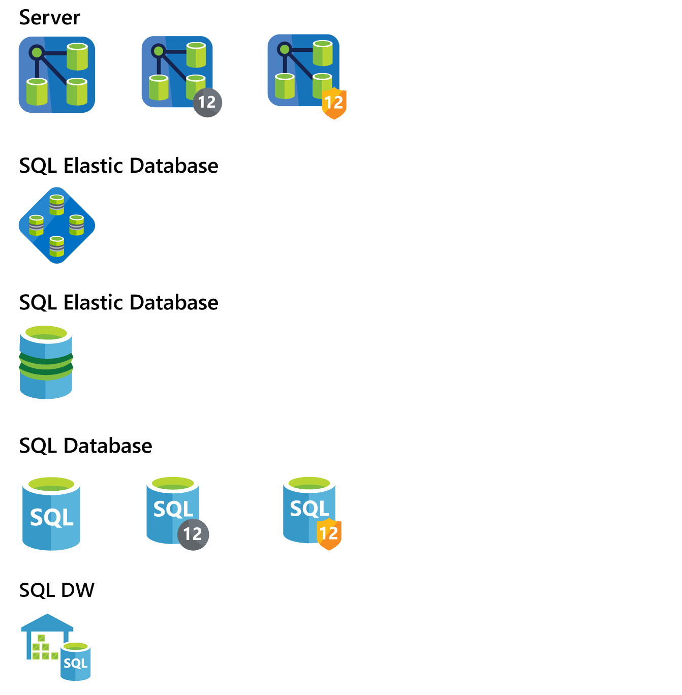
SQL Database Elastic Database service tiers
 |  | Standard Elastic Preview
Elastic Database Pools
 | Resizable eDTU range | 200–1200 DTUs
 | Resizable storage range | 200–1200 GB
 | Maximum databases per pool | 100 databases
 | Elastic database DTUs (eDTU) Each eDTU includes 1 GB of storage | $4.5 / eDTU per month (50% pricing for preview – GA price listed above)
Elastic Databases
 | eDTU max per database | Up to 100 DTUs
 | Storage max per database | Up to 250 GB
 | Elastic database fee | $2.5 / Database per month (50% pricing for preview – GA price listed above)
REVIEW SLIDE ON STORAGE RANGE

Slide 17
PREVIEW
Elastic Database Model
Elastic databases in elastic database pools
Pooled resources are used by many databases
Standard elastic pools provide 200–1,200* database throughput units (DTUs) for up to 100* databases
Elastic Standard databases can burst up to 100 DTUs (S3 level)
Create/configure pools by using the portal, Azure PowerShell, REST APIs
Move databases in/out by using the portal, Azure PowerShell, REST APIs, and T-SQL
Databases remain online throughout
Monitoring and alerting is available on both pools and databases
Max per-database burst level
DTUs
200
400
800
1,200
*Additional pricing tiers might be introduced, and the ranges and limits might be increased during the preview

Slide 18
What is difficult about building SaaS?
A SaaS model requires supporting a large number of customers
Managing many customers and databases is hard
How can you deal with isolation versus packing lots of customers into a database?
What are your resource needs and economic/business considerations?
How can you future proof for scale?
How can you handle changing business models?
Purchasing individual databases and overprovisioning to meet the variable and peak demand for each database is often not cost efficient.
One architectural pattern for SaaS applications is to create one database per end customer.

Slide 19
Elastic databases at a glance
Elastic database pools and elastic database pricing model (preview)
Elastic database tools—client library and split-merge service (GA)
Elastic database job (preview)
Elastic database queries and transactions

Slide 20



Concepts
An elastic database pool is a collection of DTUs and storage that is used by multiple databases
Elastic database jobs allow you to perform tasks across databases in the pool
Scenarios include
Performing administrative tasks, such as deploying new schema
Update reference data; for example, product information common across all databases
Rebuild indexes to improve query performance
Elastic pool
Databases consume resources as needed
Customer 1
Customer 2
Customer 3
…
Customer #N
Elastic database tools

Slide 21
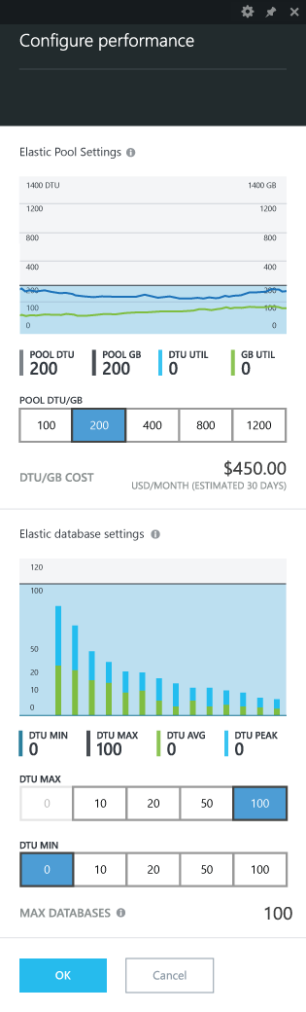
Performance settings
Set DTU guarantee for the group
The DTU guarantee should be within the system limits set for the elastic pool
Use historic utilization of the group or the desired guarantee per database and utilization of concurrently active databases to inform the size of the DTU guarantee
Set DTU cap and guarantees for the databases
DTU cap per database is applied to all databases in the group
Use peak utilization patterns of databases within the group and tolerance for overcommitting the DTU guarantee of the group to inform the cap
DTU guarantee per database sets the DTU guarantee for all databases in the group; this setting is optional

Slide 22
Demo
Elastic Pool

Slide 23
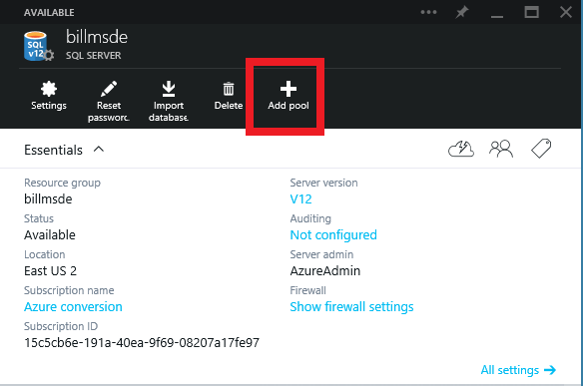
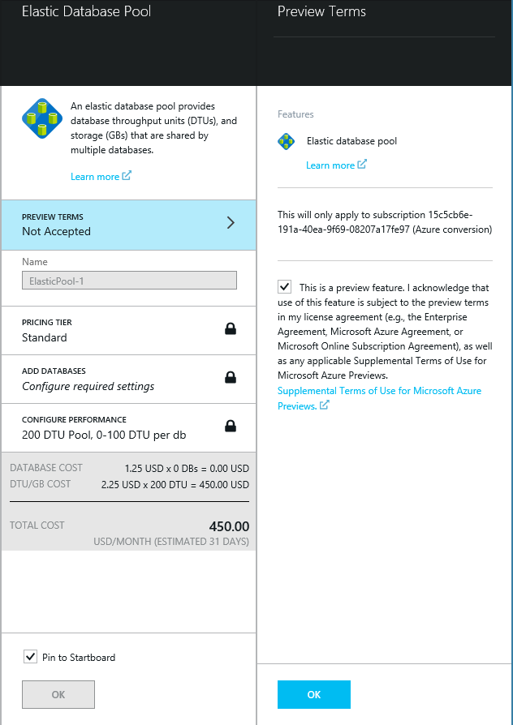
Creating an elastic database pool
From the Azure SQL Database server blade, click on Add pool.
Click on Preview Terms and accept the notice in the Preview Terms blade.

Slide 24
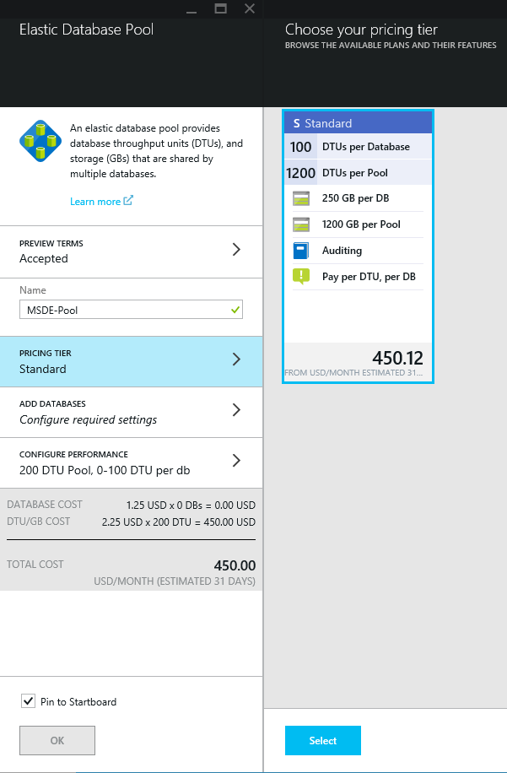
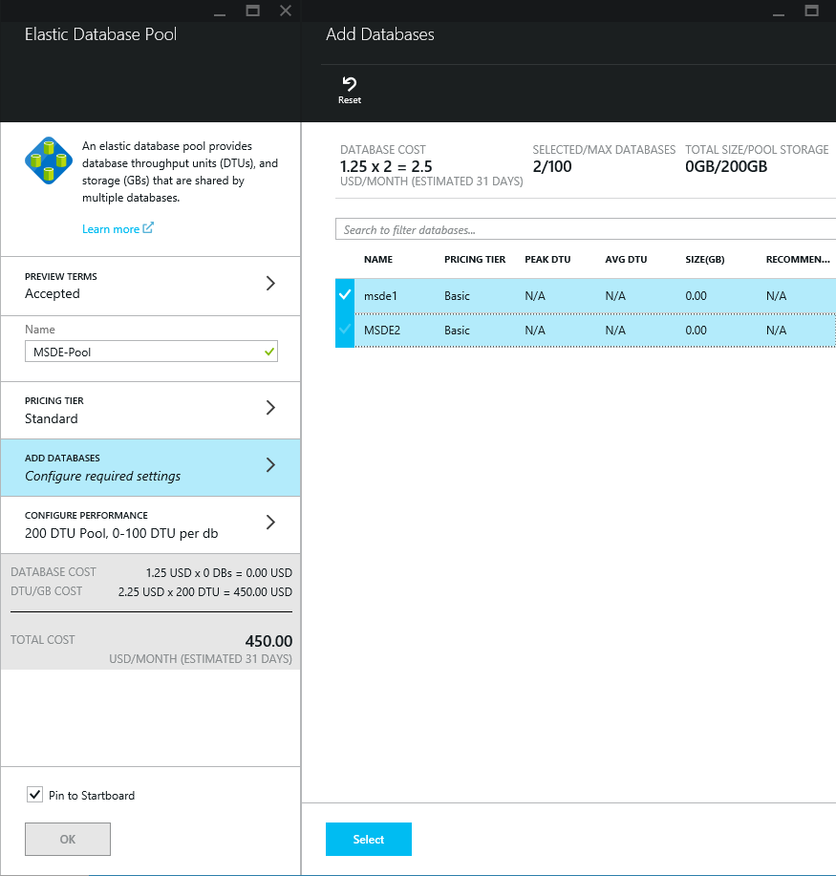
Define the elastic database pool
Enter the Name for the pool.
Specify the pricing tier; currently there is only one option.
Click ADD DATABASES and select the databases from the Add Databases blade.

Slide 25
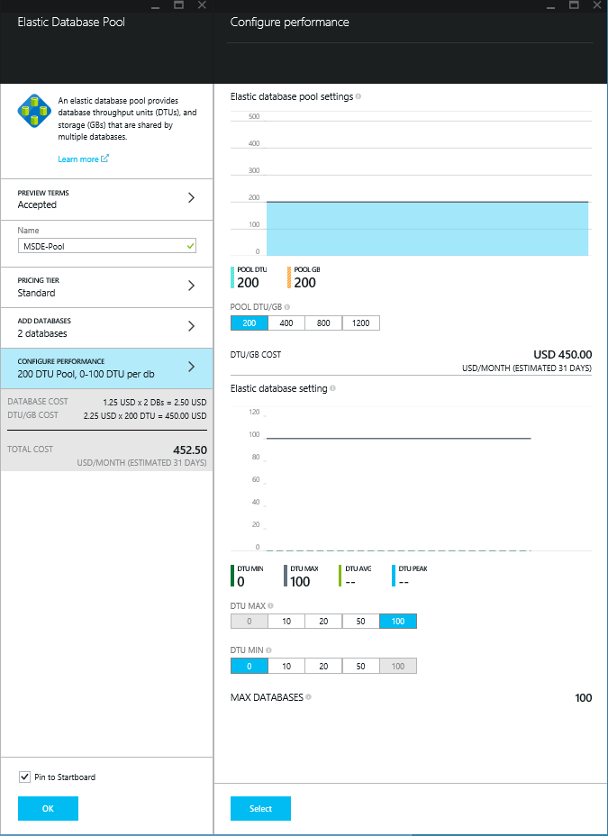
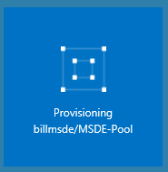
Configure the performance
Select the POOL DTU/GB value of 200, 400, 800 and 1200 - price scales lineally
Specify the elastic database DTU min and max values of 0, 10, 20, 50, 100.
Click OK to create the pool.
Azure creates the pool on the Starboard to show the status.

Slide 26
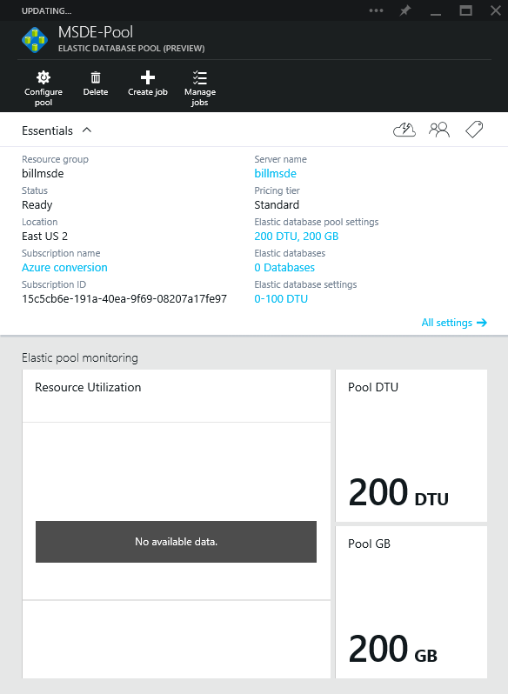
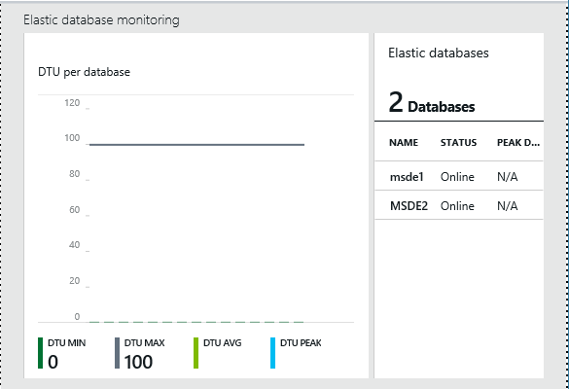
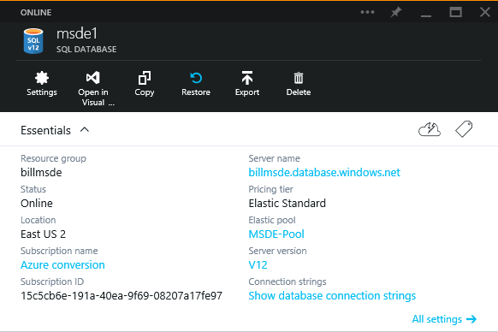
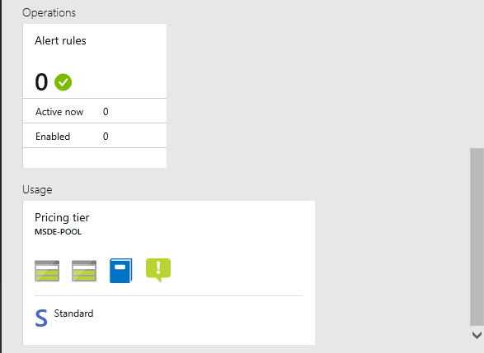
Configuration is complete
Azure displays the ELASTIC DATABASE POOL (PREVIEW) blade when it completes provisioning.
Database blade includes the elastic pool name.

Slide 27
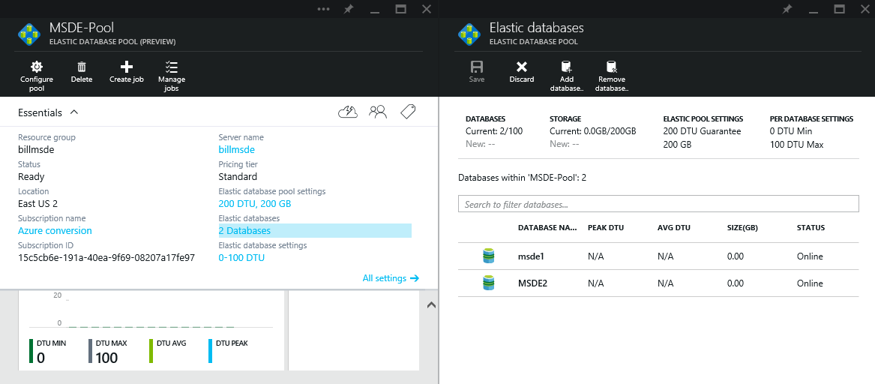
Add and remove databases from a pool
Click on the Databases link to show the Elastic databases blade.
Click Add database to add another to the pool.
Click Remove database to remove a set of databases.

Slide 28
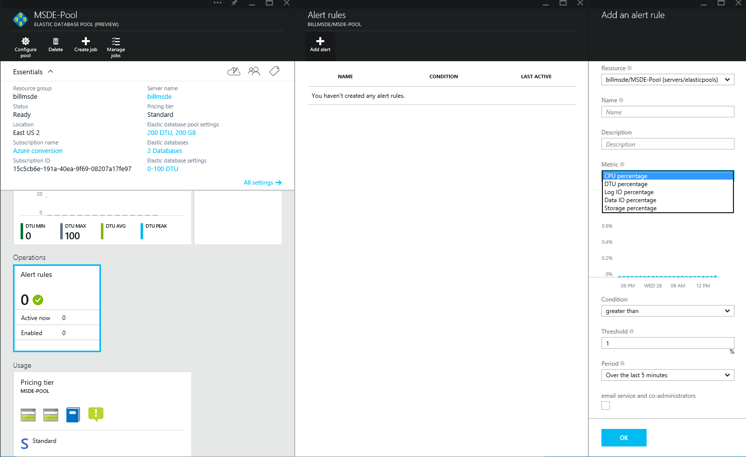
Adding alerts
Click on the Alert rules in the pool blade to add alert rules.
Click Add rule to add a new rule.
Select the Resource pool and the metric along with the other information to add an alert, and then click OK to save the changes.

Slide 29
Hands-on Lab
Implementing SQL Database

Slide 30
Elastic database tools

Slide 31
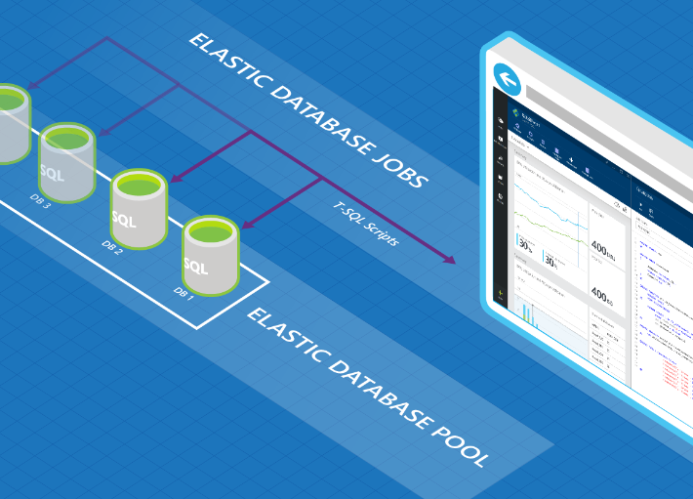
Elastic database jobs overview
Elastic database jobs enables you to run T-SQL scripts (jobs) against all of the databases in an elastic database pool
Define, maintain, and persist T-SQL scripts to be executed across an elastic database pool
Execute T-SQL scripts reliably with automatic retry and at scale
Track job execution state

Slide 32
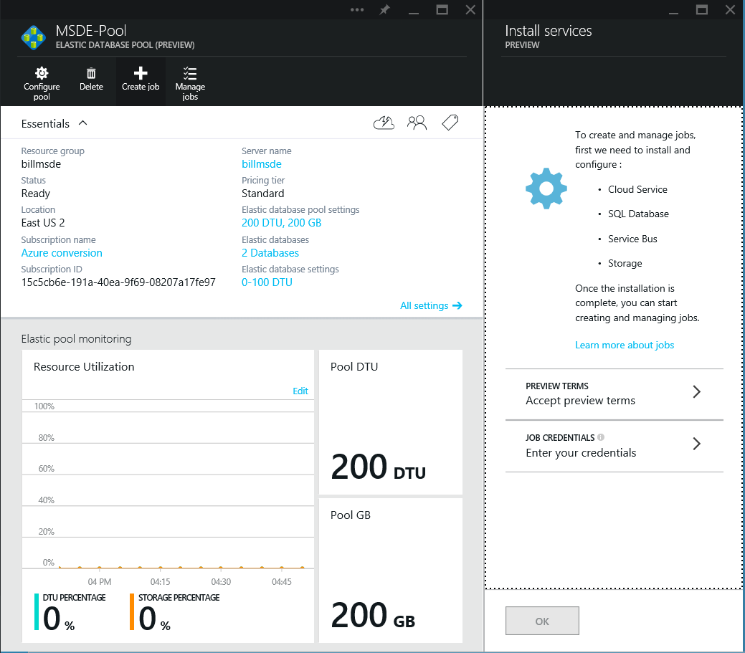
Getting started with elastic database jobs
Perform management operations on databases in Elastic Pool (the preview is just scoped to this)
Index maintenance, DDL, DML, queries delivering merged results
For the preview release, it is available as a customer-hosted service
Install and deploy the service through the portal

Slide 33
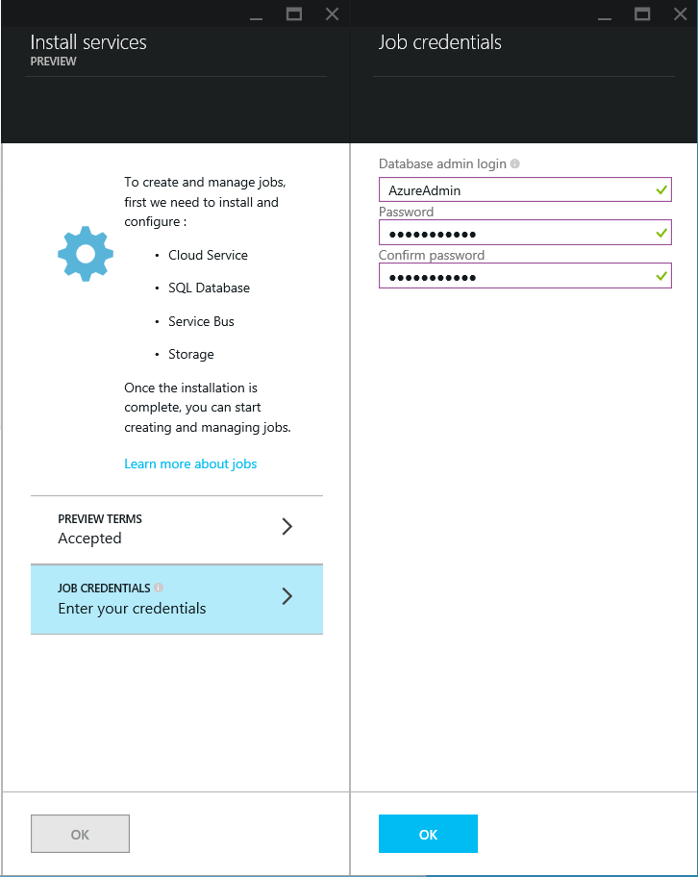
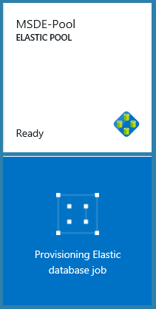
Enter in the job credentials used for services
Think of this process as enabling SQL Server Agent with the execution account credentials

Slide 34
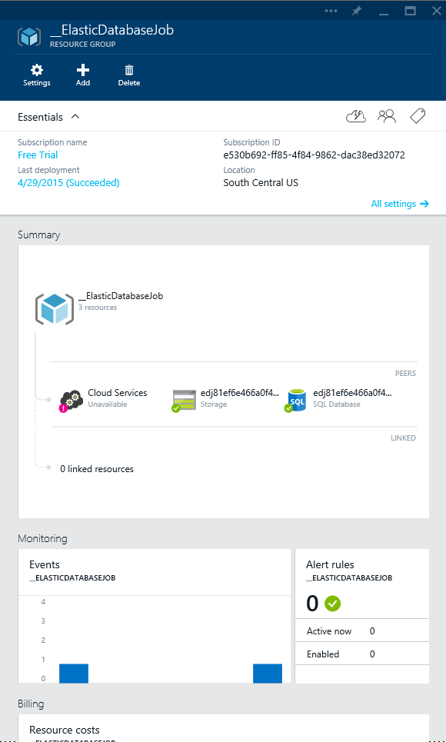
Add a new elastic job for the resource group
The service allows you to run T-SQL scripts against all of the databases in the pool in a single operation.
For example, you can set the policy on each database to allow only people with the right credentials to view sensitive data.

Slide 35
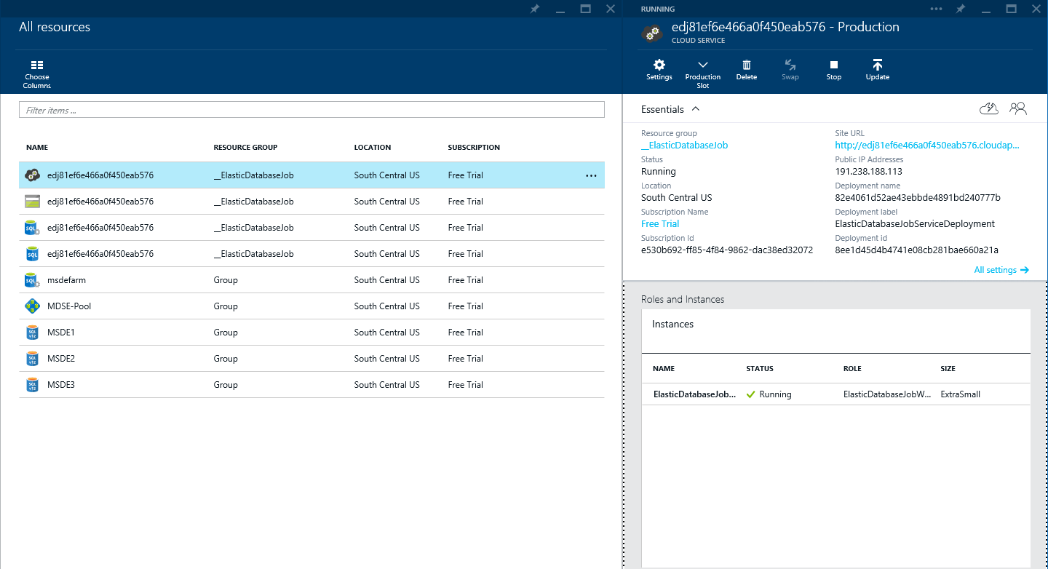
Elastic database job dependencies
Cloud service uses a Extra Small worker role VM for managing job execution
Storage account used for job management
Azure SQL Database used for job management

Slide 36
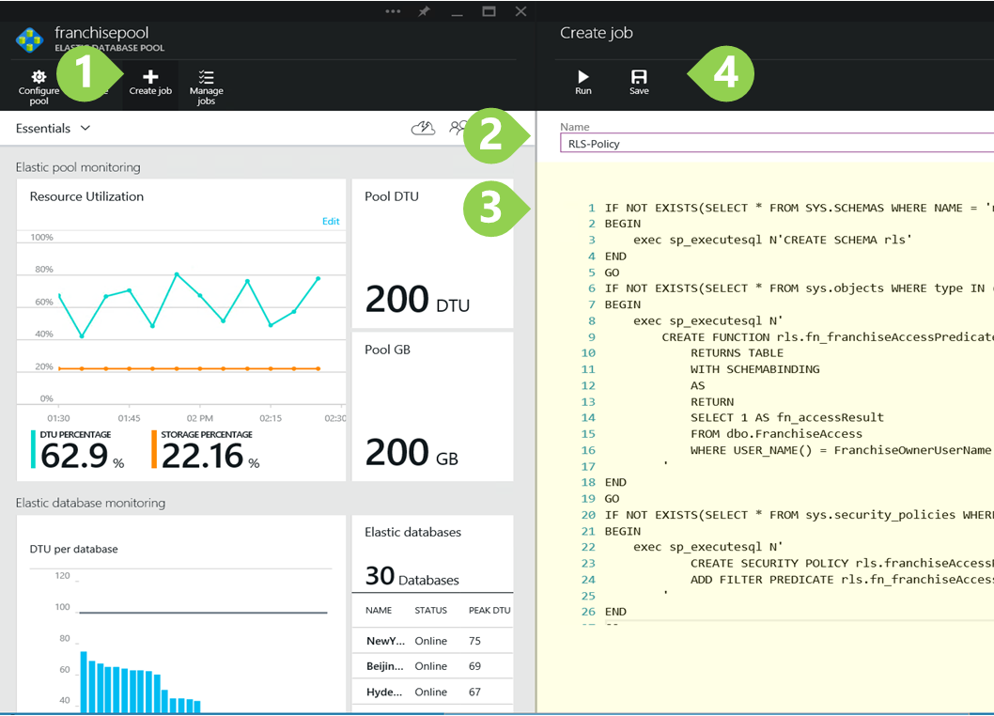
Creating a job
In the elastic database job pool blade, click Create job.
Type in the name and password of the database administrator (created at installation).
In the Create Job blade, type a name for the job.
Paste or type in the T-SQL script.
Click Save and then click Run.

Slide 37
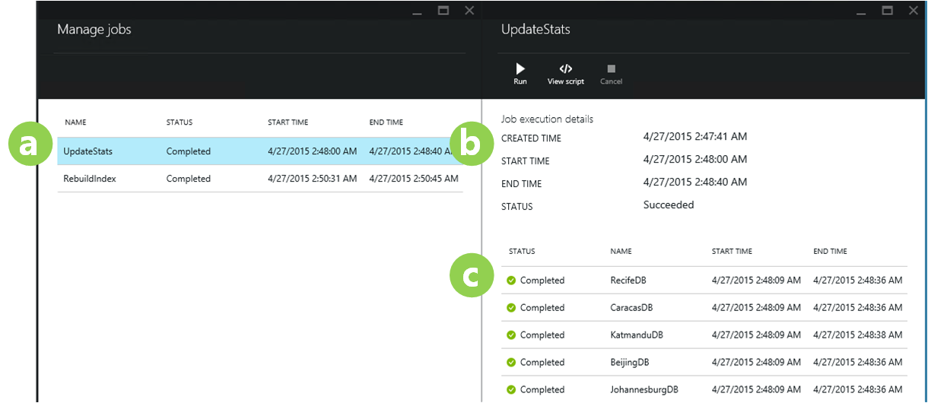
Checking job status
Click on the name (a) of a job. The STATUS can be “Completed“ or “Failed.“
The job’s details appear (b) with its date and time of creation and running.
The list below the details (c) shows the progress of the script against each database in the pool, giving its date and time details.

Slide 38
Sharding

Slide 39
When is sharding the right consideration?
Application workload can be partitioned across a number of scale units, and workload directed to each partition can fit into the biggest scale unit available.
Application workload doesn’t contain large scans or aggregations that need to touch the entire data set.
Total capacity demands (CPU, IO, memory, storage) of the application exceed the hard limits of a single Azure SQL Database scale unit.
Application requires on-demand or automatic policy-driven scale out or scale in.
Caveat: Typical data warehousing does not easily fit the patterns for Elastic Scale.

Slide 40
Performance

Slide 41
Performance predictability
Web / Business
Basic / Standard / Premium
Machine
Machine
Compute
Compute
Noisy neighbor!
DB 1 workload
DB 2 workload
DB 1 workload
DB 2 workload
DB 1 workload
DB 2 work-load
DB 3 workload
DB 3 work-load
DB 4 workload
DB 7 work-load
DB 4 workload
DB 3 workload
DB 4 workload
Introduction of
bounding boxes
to eliminate the
noisy neighbor problem
DB 4 workload
DB 5 workload
Writes
DB 7 workload
Reads
Writes
Reads
DB 5 workload
DB 6 workload
DB 7 work-load
DB 8 work-load
DB 6 workload
DB 6 workload
DB 5 workload
Memory
Memory

Slide 42
Database Transaction Unit – DTU
Bounding box
Monitoring database workload utilization within bounding box
30%
CPU
75%
Represents the relative power (resources) assigned to the database
Blended measure of CPU, memory, and read-write rates
Compare the power across performance levels
Simplifies talking about performance, think IOPS vs. %
Writes
Reads
Utilization
50%
Memory
60%

Slide 43
Azure SQL Database Benchmark – ASDB
An example representing meaningful OLTP-workload
Uses six tables of varying sizes, some of which are always larger than available memory and scale with the throughput
Uses nine transaction types
A transaction is a combination of multiple SELECT, DELETE, INSERT, and UPDATE statements

Slide 44
Resource monitoring
master.sys.resource_stats
Based on 5-minute averages
userdb.sys.dm_db_resource_stats
Based on 15-second averages
Percentages relative to performance level
Accessible though Azure Portal
Enables configuration of alerting

Slide 45
Service Tier Advisor

Slide 46
Overview
Service Tier Advisor surfaces insights into the database workload to:
Determine the optimal service tier and performance level for the database
Choosing right service tier / performance level is dependent on:
Feature usage and features available in different Service Tiers
Resource usage and bounding boxes of different Performance Levels
Service Tier Advisor takes into account:
Resource consumption
Database Size
Disaster Recovery plan
Service Tier Advisor does not take into account the following metrics as they are subjective and not measurable:
Uptime SLA
Point in time Restore
Performance Objective

Slide 47
Recommended Perf Level Constraints
Recommended performance level must support current database size and disaster recovery plan of a database.
Recommended performance level must be suitable for database resource consumption 95% of the time.

Slide 48
Service Tier Advisor Components
Basis of the Service Tier Advisor recommendations
Feature usage analysis
Resource consumption analysis

Slide 49
Feature Usage Analysis
Decision tree on the right takes into account the following features:
Database Size
Disaster Plan
Feature that requires larger service tier is marked as dominant as it sets the minimum service tier that supports all used features of a database.

Slide 50
Resource consumption analysis
Resource consumption distribution shows what percentage of active period database was consuming resources within the boundaries of different performance levels
This chart is an example of resource consumption for a single database

